Slide 1

Building an Intelligent Financial Reconciliation Agent
Automating bank statement and ledger reconciliation with AI-powered precision using Google Cloud Platform and Gemini AI integration

Slide 2
The Reconciliation Challenge
Manual Process Pain Points
Market Opportunity
Financial reconciliation remains one of the most time-intensive and error-prone activities in enterprise finance operations. Traditional approaches involve teams of analysts manually comparing thousands of transactions between bank statements and internal ledgers, often spending weeks on month-end close processes.
The enterprise reconciliation market is experiencing significant transformation. Organizations are increasingly seeking automated solutions that can handle growing transaction volumes while improving accuracy and reducing cycle times.
$2.3B global reconciliation software market by 2027
87% of CFOs prioritizing finance automation initiatives
Human error rates averaging 3-5% in manual reconciliation
Average 60-70% reduction in reconciliation time with automation
Time-consuming review cycles delaying financial close by 5-10 days
ROI typically achieved within 8-12 months of implementation
Limited scalability as transaction volumes grow
Difficulty identifying systematic discrepancies and patterns
Compliance requirements driving adoption across regulated industries
High operational costs with skilled resources required

Slide 3




Solution Overview: AI-Powered Reconciliation Agent
Our intelligent reconciliation agent leverages Google Cloud Platform's enterprise-grade infrastructure combined with Gemini AI's advanced language understanding to automate the entire reconciliation workflow. The solution ingests bank statements and ledger data, applies sophisticated matching algorithms enhanced by AI, identifies discrepancies with contextual understanding, and generates comprehensive reconciliation reports with actionable insights.
Intelligent Ingestion
AI-Enhanced Matching
Automated extraction and normalization of data from multiple bank statement formats (PDF, CSV, MT940, BAI2) and ledger systems using Document AI and custom parsers
Gemini-powered fuzzy matching algorithms that understand transaction context, vendor aliases, and accounting conventions to identify matches beyond simple rule-based systems
Exception Intelligence
Actionable Reporting
Machine learning models that categorize discrepancies, suggest probable matches, and learn from user corrections to continuously improve accuracy
Automated generation of reconciliation reports with audit trails, variance analysis, and natural language explanations of findings for stakeholder review

Slide 4
Core Input Datasets
Bank Statements
General Ledger Data
The agent processes bank statements from multiple financial institutions in various formats. These contain the actual movement of funds including deposits, withdrawals, transfers, fees, and interest. The system handles structured formats like CSV and MT940, as well as unstructured PDFs requiring OCR and Document AI extraction. Key fields extracted include transaction date, posting date, description, reference numbers, debit/credit amounts, and running balances.
Internal accounting records from ERP systems like SAP, Oracle, NetSuite, or QuickBooks provide the company's book entries. These include journal entries, accounts payable/receivable transactions, payroll entries, and inter-company transfers. The ledger data typically includes account codes, transaction descriptions, posting dates, document numbers, vendor/customer information, and amounts. The agent connects via API or processes exported files in standard formats.
Both datasets undergo extensive preprocessing including date normalization, currency standardization, duplicate detection, and data quality validation before entering the reconciliation pipeline. The system maintains complete audit trails of all transformations applied to source data.

Slide 5
Technical Architecture Overview
The solution is built on Google Cloud Platform leveraging a microservices architecture for scalability, resilience, and independent component evolution. The architecture follows cloud-native best practices with containerized services orchestrated by Google Kubernetes Engine (GKE), serverless functions for event-driven processing, and managed services for data storage and AI capabilities.
01
02
Data Ingestion Layer
Processing & Storage Layer
Cloud Storage buckets receive files via SFTP/API; Cloud Functions trigger processing; Document AI extracts unstructured data; Pub/Sub queues coordinate workflows
Cloud SQL (PostgreSQL) stores structured data; BigQuery for analytics; Dataflow processes large-scale ETL; Memorystore (Redis) for caching
03
04
AI & Matching Engine
API & Interface Layer
Vertex AI hosts Gemini models for contextual understanding; Custom Python services implement matching algorithms; Cloud Run executes reconciliation logic
Cloud Endpoints expose REST APIs; Firebase hosts web dashboard; Identity Platform manages authentication; Cloud Armor provides security

Slide 6





Functional Architecture: Process Flow
Data Collection & Validation
The system receives bank statements and ledger exports through secure channels. Automated validation checks verify file integrity, format compliance, and data completeness. Files are parsed, normalized, and stored in standardized schemas. Data quality metrics are calculated and anomalies flagged for review before processing begins.
Preprocessing & Normalization
Raw transaction data undergoes extensive cleaning and standardization. Dates are converted to ISO format, amounts normalized to base currency, descriptions cleaned of special characters, and merchant names standardized. The agent applies learned transformations from historical data to improve consistency across data sources.
Intelligent Matching & Reconciliation
The core matching engine applies multiple strategies: exact matching on unique identifiers, fuzzy matching with configurable thresholds, date range matching for timing differences, and AI-powered semantic matching using Gemini. Matches are scored by confidence level, with high-confidence matches auto-approved and low-confidence flagged for review.
Exception Handling & Learning
Unmatched items are analyzed and categorized by exception type: timing differences, missing transactions, amount discrepancies, or duplicate entries. The Gemini model suggests probable matches with explanations. User feedback on accepted/rejected suggestions trains the model to improve future accuracy.
Report Generation & Audit Trail
Comprehensive reconciliation reports are generated showing matched items, outstanding exceptions, and summary statistics. All system actions are logged with timestamps, user attribution, and reasoning. Reports are exportable in multiple formats and maintain full audit compliance for regulatory requirements.

Slide 7

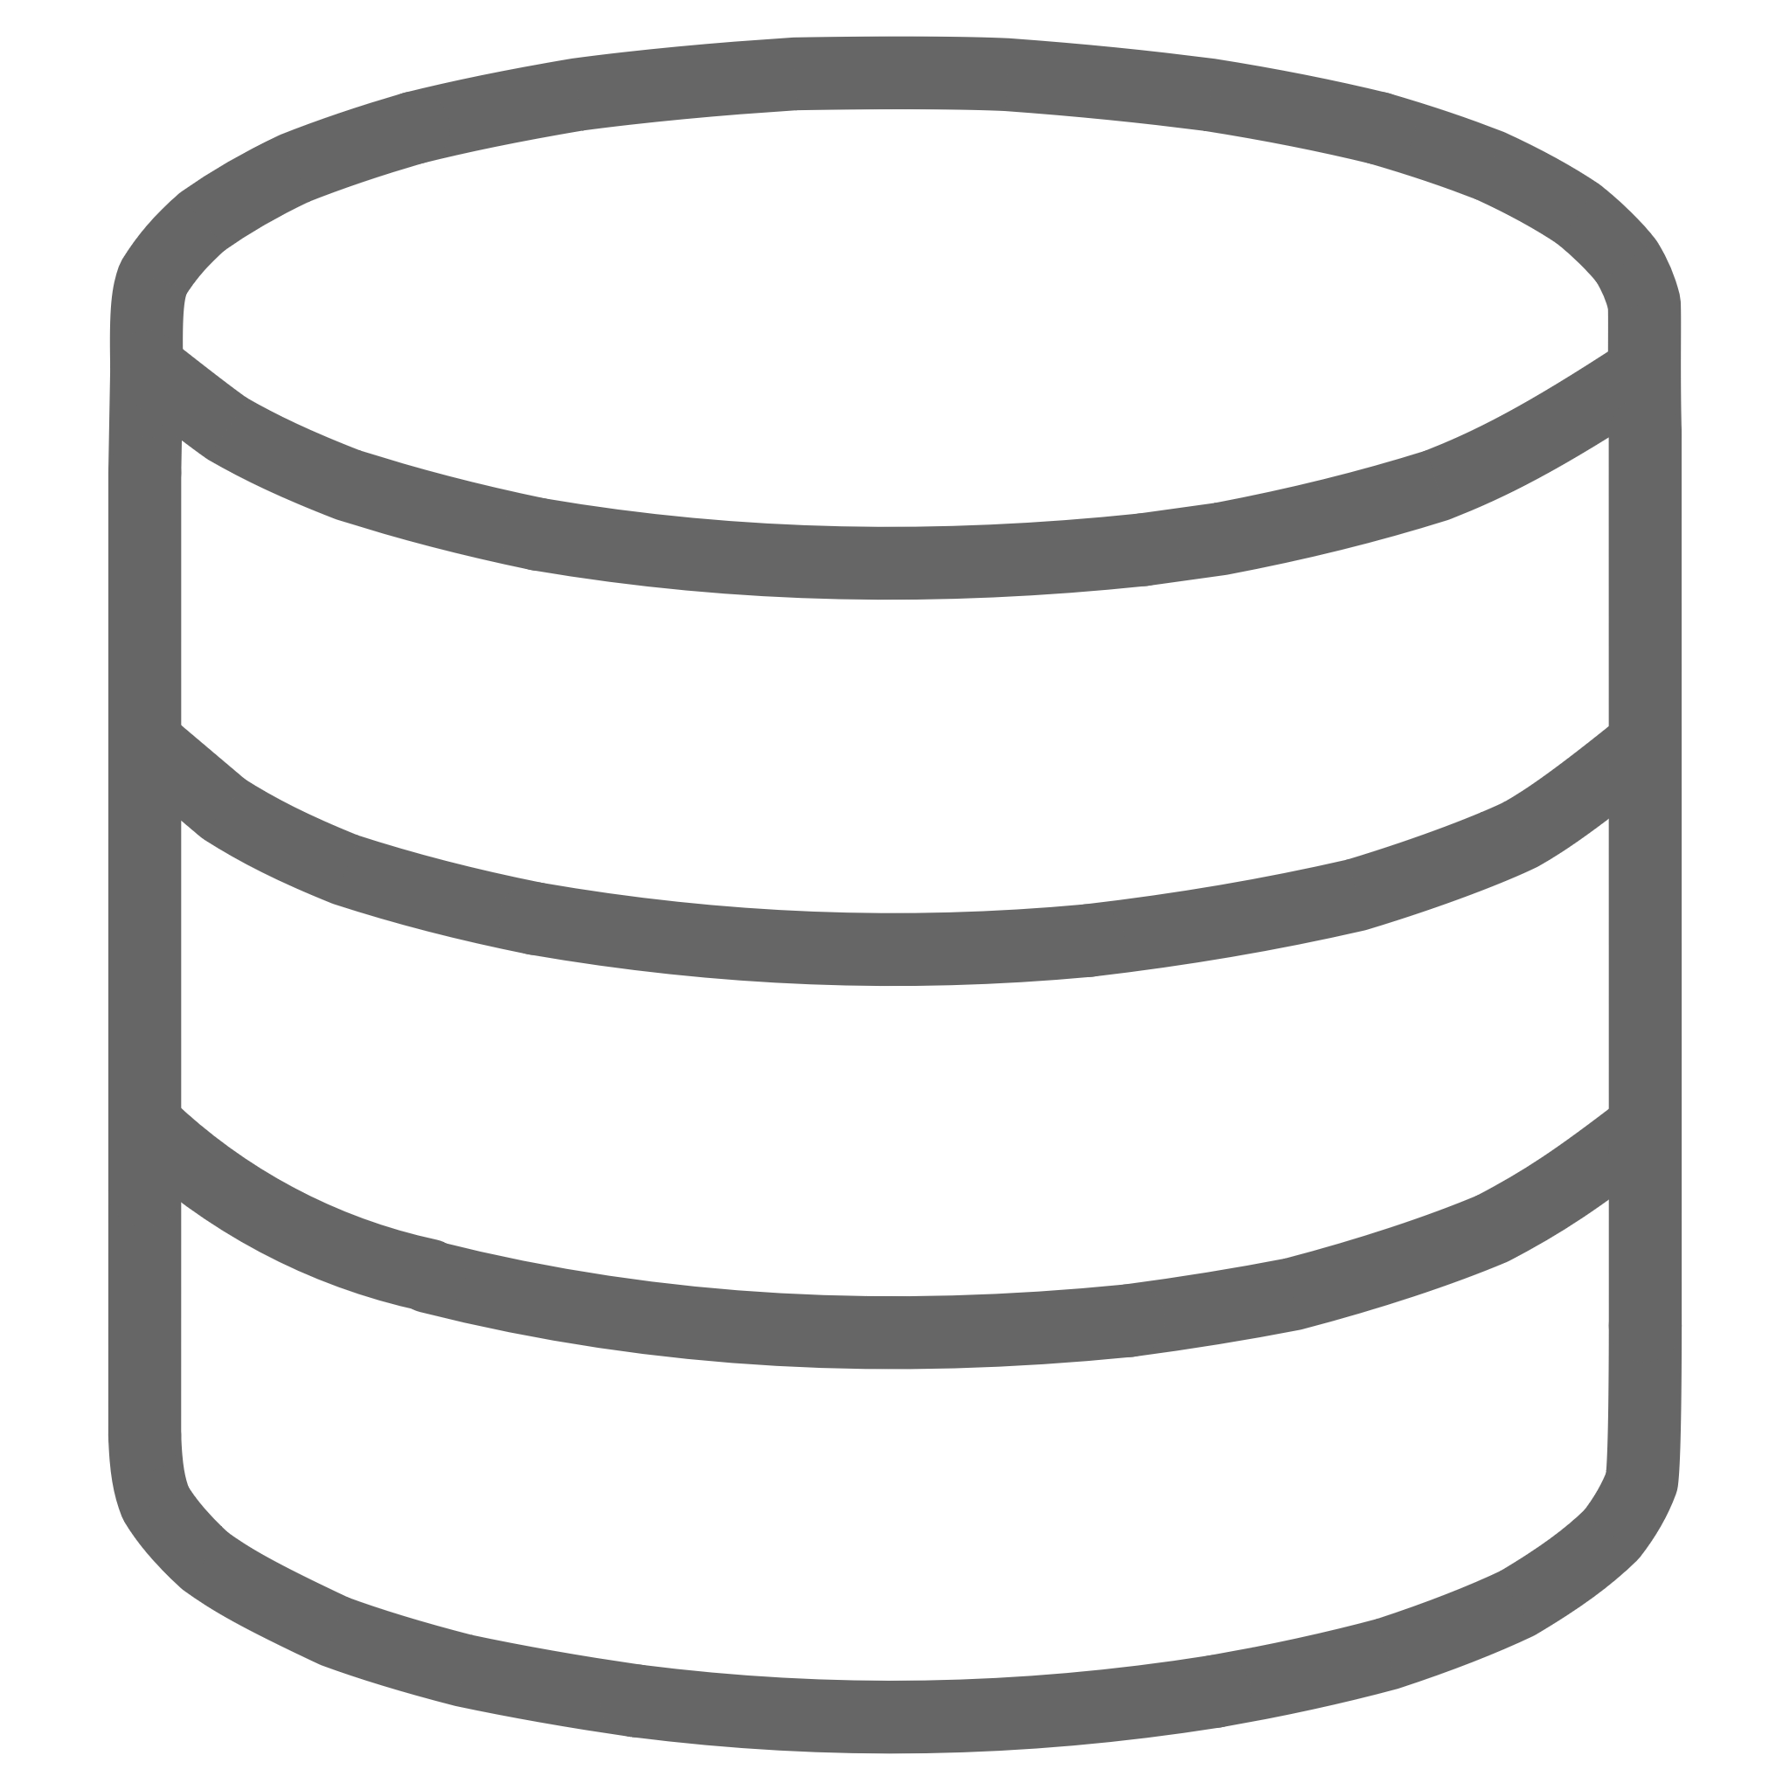


Google Cloud Platform: Deployment Architecture
The solution leverages GCP's comprehensive service portfolio to build a production-grade, enterprise-ready reconciliation platform. Our deployment strategy emphasizes high availability, security, scalability, and operational excellence through infrastructure-as-code and automated DevOps practices.
Compute Infrastructure
Data & Storage Services
Google Kubernetes Engine (GKE): Hosts microservices with auto-scaling node pools, regional clusters for high availability, and workload identity for secure service authentication.
Cloud SQL (PostgreSQL): Primary transactional database with high availability configuration, automated backups, point-in-time recovery, and read replicas for reporting queries.
Cloud Run: Serverless containers for reconciliation jobs that scale to zero when idle, reducing costs while maintaining sub-second cold start times for batch processing.
BigQuery: Analytics data warehouse for historical reconciliation data, trend analysis, and complex queries across years of transaction history with sub-second response times.
Cloud Functions (2nd gen): Event-driven processing for file uploads, notifications, and lightweight transformation tasks with automatic scaling and built-in retry logic.
Cloud Storage: Object storage for raw files, processed datasets, and report archives organized in lifecycle-managed buckets with encryption at rest and in transit.
AI & Machine Learning
Security & Networking
Vertex AI: Managed platform hosting Gemini Pro models for natural language understanding, custom models for transaction classification, and AutoML for pattern detection.
VPC Service Controls: Security perimeters protecting sensitive financial data with private connectivity between services and no public internet exposure for data processing.
Identity Platform: Enterprise SSO integration with OAuth 2.0, SAML support, and multi-factor authentication for all user access with granular role-based permissions.
Document AI: Pre-trained parsers for bank statement extraction from PDFs with custom processors fine-tuned on client-specific document formats and layouts.
Cloud Armor: DDoS protection and WAF rules protecting API endpoints from malicious traffic with geo-filtering and rate limiting capabilities.
Vertex AI Workbench: Jupyter notebooks for data scientists to develop, test, and refine matching algorithms and ML models in collaborative environments.
Secret Manager: Centralized management of API keys, database credentials, and certificates with automatic rotation and audit logging of all access.

Slide 8

Gemini AI Integration: Powering Intelligence
Why Gemini for Reconciliation?
Gemini AI's multimodal capabilities and advanced reasoning make it uniquely suited for financial reconciliation tasks that require understanding context, interpreting variations in transaction descriptions, and providing human-like judgment on ambiguous matches.
The model's ability to process both structured data and unstructured text enables it to understand transaction narratives, vendor name variations, and accounting conventions that traditional rule-based systems struggle with.
Semantic Transaction Matching
Natural Language Explanations
Gemini analyzes transaction descriptions beyond keyword matching, understanding that "AMZN MKTP" and "Amazon Marketplace Purchase" refer to the same entity. It interprets abbreviations, codes, and vendor naming variations, significantly improving match rates for transactions with inconsistent descriptions across bank statements and ledgers.
For each suggested match or identified discrepancy, Gemini generates human-readable explanations detailing its reasoning. This transparency builds user trust and accelerates the review process. Example: "These transactions likely match despite the $0.15 difference because bank fees were deducted from the bank side, as evidenced by the fee line item immediately following."
Continuous Learning from Feedback
Contextual Exception Classification
As users accept or reject Gemini's suggestions, the system captures this feedback to fine-tune the model through reinforcement learning. Over time, the agent learns organization-specific patterns, vendor relationships, and accounting practices, becoming increasingly accurate and reducing the volume of items requiring human review.
The model categorizes unmatched items by analyzing patterns, timing, and descriptions. It distinguishes between timing differences (transactions in transit), genuine discrepancies requiring investigation, and systematic issues (like recurring bank fees not recorded in ledger) that need process adjustments rather than individual resolution.

Slide 9
Python Technology Stack
The reconciliation agent is built primarily in Python, leveraging its rich ecosystem of libraries for data processing, machine learning, and cloud integration. Python's readability and extensive community support enable rapid development while maintaining code quality and maintainability.
Core Framework & APIs
Data Processing & Analysis
FastAPI: High-performance async web framework for REST APIs with automatic OpenAPI documentation
Pandas: DataFrames for transaction data manipulation, filtering, and transformation
Pydantic: Data validation and settings management using Python type hints
NumPy: Numerical computing for matching score calculations and statistical analysis
SQLAlchemy: ORM for database interactions with migration management via Alembic
Apache Beam: Unified programming model for batch and streaming data processing pipelines
Celery: Distributed task queue for async processing with Redis broker
FuzzyWuzzy: String matching library for comparing transaction descriptions
AI & Machine Learning
GCP Integration & Utilities
google-cloud-aiplatform: Vertex AI SDK for Gemini model integration and predictions
google-cloud-storage: Cloud Storage client for file operations and bucket management
LangChain: Framework for building LLM-powered applications with prompt engineering
google-cloud-pubsub: Messaging service client for event-driven architecture
scikit-learn: Traditional ML algorithms for classification and clustering tasks
google-cloud-sql: Cloud SQL connectors with connection pooling
TensorFlow: Deep learning framework for custom neural network models
google-cloud-documentai: Document AI client for PDF parsing and OCR

Slide 10
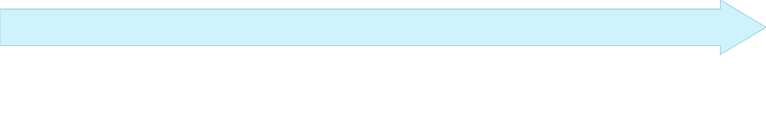
Matching Algorithm: Multi-Strategy Approach
The reconciliation engine employs a sophisticated multi-tier matching strategy that progresses from exact matches to increasingly complex AI-powered matching techniques. This layered approach optimizes for both speed and accuracy, with simpler matches resolved quickly while complex cases receive deeper analysis.
Tier 2: Rule-Based Matching
Tier 1: Exact Key Matching
Applies configurable business rules matching on combinations of amount, date range (±3 days), and partial description matches. Uses hash-based lookups for performance. Handles common scenarios like timing differences from payment processing delays or different date recording conventions between systems.
Matches on unique identifiers like transaction IDs, check numbers, or invoice references. Fastest method with 100% confidence. Accounts for approximately 40-50% of transactions in typical enterprise environments. Includes validation of amounts and dates to prevent false positives from reused identifiers.
Tier 4: AI Semantic Matching
Tier 3: Fuzzy Matching
Leverages Gemini to understand transaction context and meaning. Analyzes full transaction narratives, interprets abbreviations, recognizes entity relationships, and considers historical patterns. Provides natural language explanations for suggested matches. Learns from user feedback to improve over time. Reserved for complex cases that fail simpler matching strategies.
Employs string similarity algorithms (Levenshtein distance, token set ratio) to match transactions with description variations. Configurable thresholds balance false positives vs. false negatives. Particularly effective for vendor name variations, typos, and abbreviations. Matches scored from 0-100 with confidence bands.
Each transaction progresses through tiers until a match is found or all strategies are exhausted. The system tracks which strategy produced each match, enabling continuous optimization of matching rules and thresholds based on success rates and user acceptance patterns.

Slide 11






Key Features & Capabilities
Real-Time Processing
High Accuracy Matching
Process reconciliation jobs within minutes rather than days. Stream processing capabilities enable near-real-time reconciliation as transactions occur, rather than waiting for month-end batch processing. Immediate identification of discrepancies allows faster resolution and reduces accumulation of unreconciled items.
Achieve 95%+ auto-match rates through AI-enhanced algorithms that understand context and learn from patterns. Reduction in false positives through confidence scoring ensures that automated matches are reliable. Human review focused only on genuinely ambiguous cases, maximizing efficiency of reconciliation team time.
Audit Trail & Compliance
ERP Integration
Complete lineage tracking from source data through matching decisions to final reports. Every system action logged with user attribution, timestamps, and reasoning. Supports SOX, SOC 2, and industry-specific regulatory requirements. Immutable audit logs stored in tamper-evident storage with cryptographic verification.
Native connectors for major ERP systems including SAP, Oracle Financials, NetSuite, Microsoft Dynamics, and QuickBooks. Bidirectional APIs enable both data extraction and posting of reconciliation results back to source systems. Handles complex scenarios like multi-currency, inter-company transactions, and multi-entity consolidations.
Analytics & Insights
Collaborative Workflow
Built-in dashboards showing reconciliation KPIs: match rates, exception trends, cycle time, and team productivity. Predictive analytics identify potential issues before they impact month-end close. Historical trend analysis reveals systematic problems requiring process improvements. Custom reports exportable to BI tools like Looker or Tableau.
Role-based access controls with segregation of duties between preparers and reviewers. Exception assignment and tracking with email notifications and due date management. Comments and annotations on individual items for knowledge sharing. Approval workflows with electronic signatures for final sign-off on reconciliation reports.

Slide 12
Implementation Roadmap
Phase 1: Foundation (Weeks 1-4)
Phase 3: AI Integration (Weeks 9-12)
GCP project setup with landing zone architecture. Infrastructure-as-code using Terraform for reproducible deployments. Development environment provisioning. Core data models and database schemas. Basic ingestion pipeline for CSV files. Authentication and authorization framework implementation.
Vertex AI platform configuration and Gemini model deployment. LangChain implementation for prompt engineering. Semantic matching algorithm integration. Document AI setup for PDF bank statement parsing. AI model evaluation and tuning. User acceptance testing with pilot users.
1
2
3
4
Phase 2: Core Matching (Weeks 5-8)
Phase 4: Production Launch (Weeks 13-16)
Implementation of Tier 1-3 matching algorithms. Cloud SQL database optimization for matching queries. API development for reconciliation operations. Basic web UI for viewing matches and exceptions. Unit and integration testing framework. Performance benchmarking with sample datasets.
ERP system integration and data pipeline hardening. Production environment deployment with security hardening. Monitoring and alerting configuration. User training and documentation. Parallel run with existing process for validation. Go-live with phased rollout across entities. Post-launch support and optimization.

Slide 13
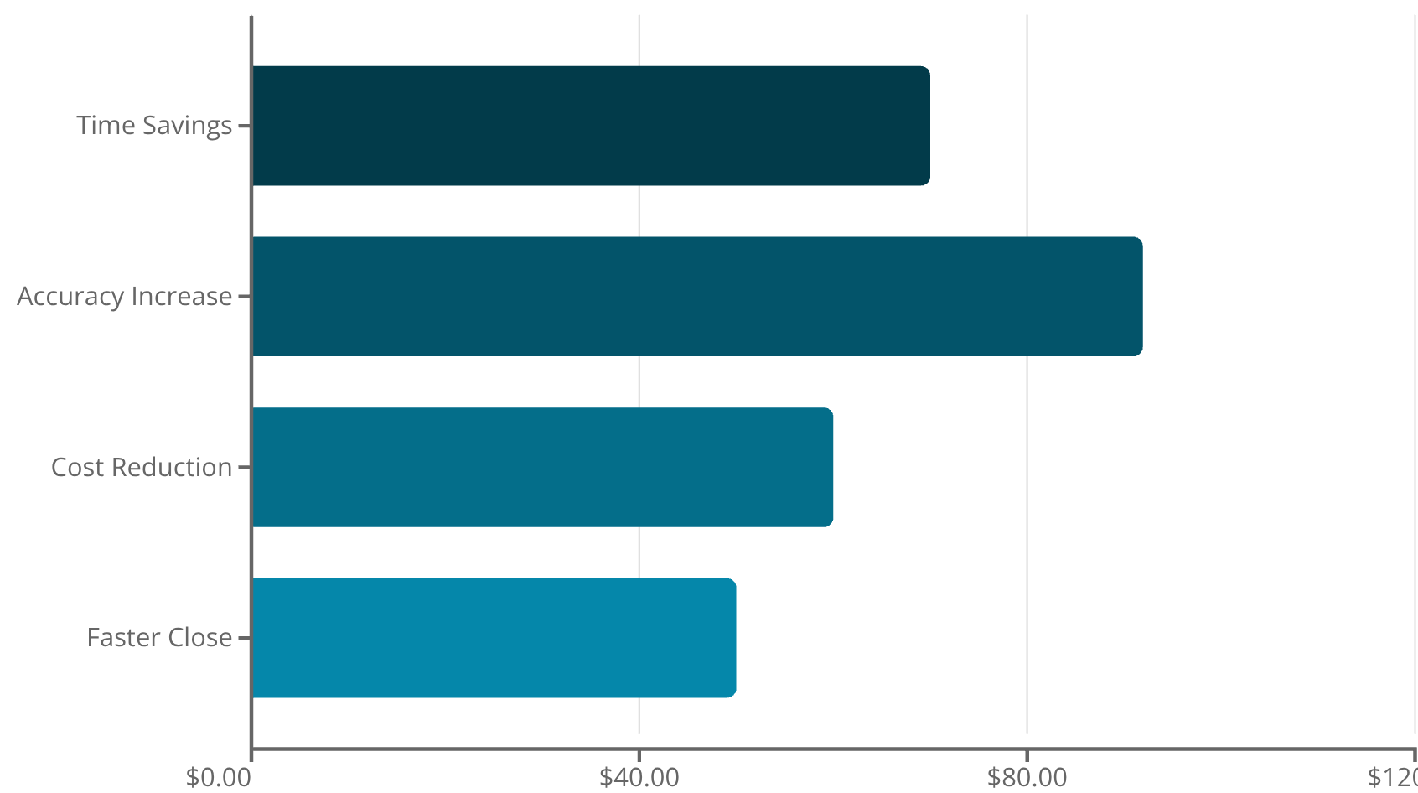
Expected Benefits & ROI
Quantifiable Impact
Organizations implementing automated reconciliation solutions typically see dramatic improvements across multiple dimensions of their financial operations.
Time savings: Reduction in manual effort allows teams to focus on value-added analysis rather than data matching
Accuracy: Elimination of human error and consistent application of matching logic
Cost reduction: Lower headcount requirements and reduced need for external audit support
Faster close: Accelerated month-end and quarter-end close cycles improving reporting agility
8-12
95%
$450K
5
Months to ROI
Auto-Match Rate
Annual Savings
Days Faster Close
Typical payback period based on labor savings and error reduction
Percentage of transactions matched without human intervention
Average cost reduction for mid-sized enterprise (1M transactions/year)
Reduction in time from month-end to completed reconciliation

Slide 14
Security & Compliance Framework
Financial data security is paramount. Our solution implements defense-in-depth security architecture with multiple layers of protection, meeting the stringent requirements of financial services, healthcare, and other regulated industries.
Data Encryption
Access Controls
Encryption at rest using Google-managed or customer-managed encryption keys (CMEK) with Cloud KMS. All data in Cloud SQL, BigQuery, and Cloud Storage encrypted by default. Encryption in transit using TLS 1.3 for all network communications. Field-level encryption for highly sensitive data like account numbers using application-layer encryption before storage.
Identity and Access Management (IAM) with principle of least privilege. Service accounts with workload identity for inter-service authentication. Multi-factor authentication required for all human users. Role-based access control (RBAC) with separation of duties between data entry, reconciliation, and approval roles. Just-in-time access provisioning for administrative tasks.
Network Security
Compliance & Auditing
VPC Service Controls creating security perimeters around sensitive data. Private Google Access for services without public IP exposure. Cloud Armor WAF protecting API endpoints from common attacks. DDoS protection with automatic scaling and traffic filtering. Network policies restricting pod-to-pod communication in GKE. VPN or Dedicated Interconnect for hybrid connectivity.
Cloud Audit Logs capturing all API calls and data access events. Security Command Center providing unified security and risk dashboard. Data Loss Prevention (DLP) scanning for sensitive information in files. Compliance with SOC 2 Type II, ISO 27001, PCI-DSS requirements. Regular vulnerability scanning and penetration testing. Automated compliance reporting for regulatory filings.

Slide 15


Next Steps: Partner With Us
Ready to Transform Your Reconciliation Process?
Our team of cloud architects, data engineers, and AI specialists is ready to help you build and deploy an intelligent reconciliation solution tailored to your organization's specific needs. We offer flexible engagement models from consulting partnerships to fully managed solutions.
What You Get:
Comprehensive discovery workshop to understand your current processes and pain points
Detailed solution architecture customized for your ERP systems and data volumes
Proof-of-concept implementation demonstrating matching accuracy on your actual data
Full production deployment with knowledge transfer to your engineering team
Ongoing support and optimization as your needs evolve
Contact us today to schedule a demonstration and discuss how AI-powered reconciliation can accelerate your financial close, improve accuracy, and free your team to focus on strategic analysis rather than manual data matching.

